Slide 1

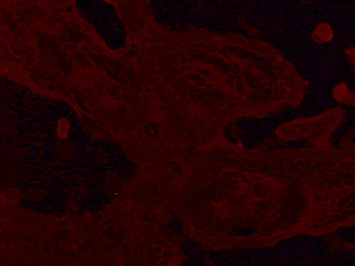
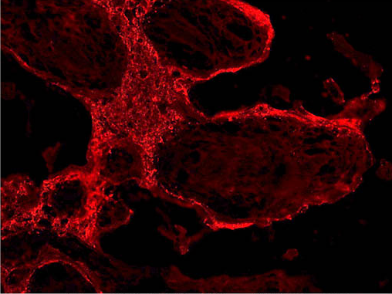
ReliaTech GmbH
Anti-human PlGF #3B10
(Cat# 101-M65)
Human Placenta Tissue (Cryo section)
Control
Anti-human PlGF #3B10
The experiment was performed by PD. Dr. Jörg Wilting, Pädiatrie I, Zentrum für Kinderheilkunde und Jugendmedizin in Göttingen, Germany.
http://www.reliatech.de / orders@reliatech.de

